Slide 1
IE7615 / PROJECT PRESENTATION
Celebrity Identification & Detection
Combining image classification and object detection
GOAL Detect multiple faces in an image and identify five celebrity identities.
01
02
03
04
Classification
Dataset
Detection
Integration
Compare CNN models
Build synthetic group images
Fine-tune YOLOv8
Combine into one pipeline

Slide 2
Dataset Construction
From individual portraits to multi-face detection training
121
576
1,820
Original CelebA photos
Final images
Labeled faces
• 800 × 600 synthetic images with 2–5 celebrities
• Varied scale, position, brightness, and backgrounds
• YuNet bounding boxes saved as YOLO annotations
DATA SPLIT 504 train / 36 validation / 36 test
Notes:
• Started with 121 celebrity photos from CelebA
• Needed more images with multiple people
• Made synthetic images with 2–5 celebrities each
• Changed positions, sizes, lighting, and backgrounds
• Used YuNet to draw face boxes; saved labels in YOLO format
• Final dataset: 576 images and 1,820 labeled faces
• Split: 504 train, 36 validation, 36 test
• Kept original photos separate across splits to avoid data leakage

Slide 3
Integrated Recognition Pipeline
Face detection and image classification work together
YOLOv8n
ResNet18
Finds each face in the image and provides bounding boxes and identity scores.
Classifies a portrait crop of each detected face across the five target identities.
Combined identity score
50% YOLOv8n + 50% ResNet18
The app compares the fused confidence with the unknown threshold.
Notes:
Our project combines the detector from Milestone 3 with the classifier from Milestone 1. YOLOv8n first locates faces. ResNet18 then classifies a portrait crop of each face. The demo averages the models’ identity scores with equal weights at the displayed default setting. This gives us one fused prediction and confidence for each detected face.
Sources: Demo interface supplied by Murat Akca, image(20261019-183443).png. Original project overview in slides 1 and 2.

Slide 4
Recognition Results
The output combines visual labels with model-level details
Named face
Colored box with a predicted identity and a confidence score.
Unknown
Gray box when fused confidence is below the default threshold of 0.61.
Faces table
Each model’s prediction and score, box coordinates, and detection stage.
No face detected
ResNet18 classifies the whole image as a fallback.
Notes:
A named result includes a colored box, the predicted identity, and a confidence score. The gray unknown label appears when the fused confidence falls below the configured threshold. The interface shows a validated default of 0.61. We can inspect the Faces table to compare the detector and classifier predictions. The app also describes a fallback: if it finds no face, ResNet18 classifies the whole image. A confidence score should still be checked against the image rather than treated as proof of a correct prediction.
Sources: Murat Akca’s instructions, image(20261019-183433).png. Demo interface, image(20261019-183443).png.

Slide 5
Running the Local Demo
The app runs locally on the presenter’s laptop
01
Project environment
Open a terminal in the repository root and activate the project environment.
02
Launch command
python project_milestone04/demo.py
03
Browser address
http://127.0.0.1:7860
Keep the terminal open while using the app.
Notes:
Before the live demonstration, open the repository in a terminal and activate the project’s existing environment. Run the command exactly as shown from the repository root. Then open the local address in the browser. Keep that terminal session open because it runs the app. The address 127.0.0.1 refers to the presenter’s own computer. Use the configured project environment and its existing model files.
Sources: Murat Akca’s laptop launch instructions, image(20261019-183433).png.

Slide 6
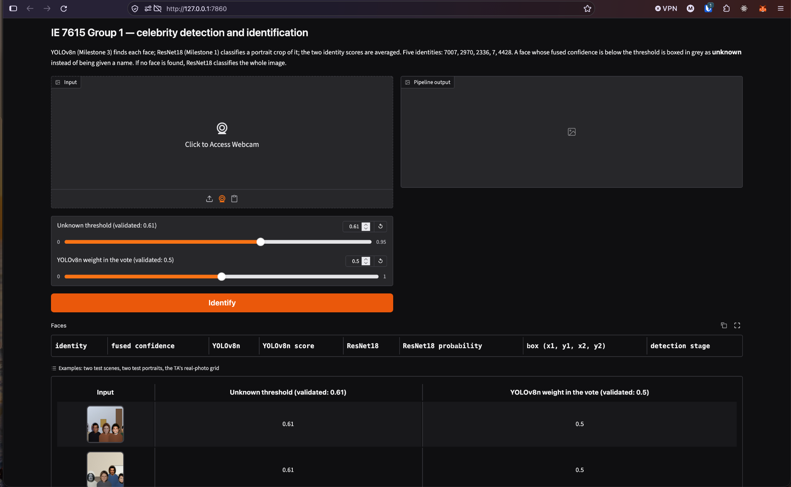
Demo Controls
Upload an image, paste a screenshot, or use the webcam
Image input
Drag a file into Input, paste with Ctrl/Cmd+V, or use the webcam.
Default settings
Unknown threshold: 0.61
YOLOv8n weight: 0.50
Identify runs the prediction.
Results appear when an image loads. The Faces table shows the details.
Notes:
The left side accepts the input image and the right side displays the annotated output. Murat describes three input methods: dragging an image, pasting a screenshot, or using the webcam. The screenshot shows an unknown threshold of 0.61 and a YOLOv8n voting weight of 0.50. Keep those defaults for the initial demonstration. The app displays results when an image loads, and the Identify button provides an explicit prediction control. Inspect the Faces table below the image output for model-level details.
Sources: Interface image supplied by Murat Akca, image(20261019-183443).png, cropped within the slide to show the app. Input behavior from image(20261019-183433).png.

